Slide 1
My final project
Afraim Adel Karzy

Slide 2
The Unplanned Attack
SCENARIO: A hacktivist group threatens to target your organization following an incident
involving an allegation of use of excessive force by law enforcement. You do not know the
nature of the attack they are planning. How can you improve your posture to best protect your
organization?

Slide 3
introduction
Addressing a potential threat from a hacktivist group requires a multi-faceted approach that combines technical measures, organizational preparedness, and effective communication. Here are steps you can take to improve your organization's posture and protect against an unplanned attack

Slide 4
Why cyber security matters to schools?
Safeguarding Communication Systems: Email and other communication platforms used by schools may contain sensitive information. Cybersecurity measures help protect these communication channels from phishing attacks, malware, and other threats that could compromise the confidentiality and integrity of messages
Protecting Financial Systems: Schools manage budgets, payroll, and other financial transactions, making them potential targets for cybercriminals. Securing financial systems is crucial to prevent fraud, embezzlement, or any other financial crimes that could negatively impact the school's operations.

Slide 5
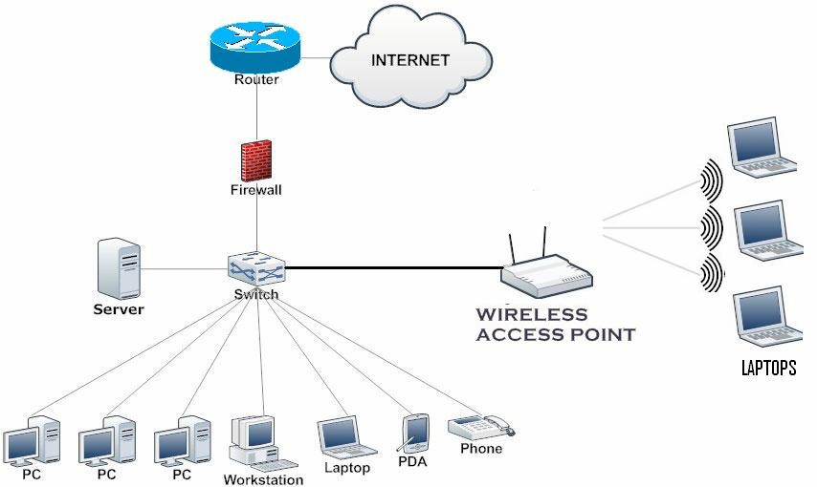
The topology before
ESA

Slide 6
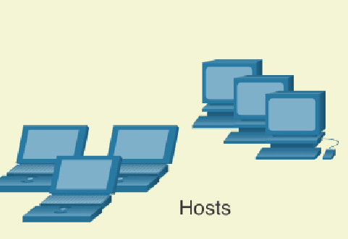
The topology after
AAA Server
int
FG-100F
Firwall
Switch layer 3
VPN
Switch layer 2
DHCP SERVER
WEB SERVER
EMIL SERVER

Slide 7
ComponeNt :
• VPN
• FG-100F Firewall
• AAA Server

Slide 8
Description :
1 VPN stands for Virtual Private Network. It is a technology that allows you to create a secure and encrypted connection over the internet, providing privacy and security for the data you transmit and receive online.
2. The Fortinet FG-100F is part of Fortinet's FortiGate series of firewalls. The naming convention for Fortinet's firewall products typically includes the model number, such as "FG-100F," where "FG" stands for FortiGate. The "100F" in this case likely represents the specific model or series identifier.
3. IPS (Signature Based) will be used to identify signatures and prevent malicious data
4. The term "AAA server" typically refers to a server that performs authentication, authorization, and accounting functions in network security and access control. The AAA framework is commonly used in computer networks to control access to resources and ensure the security of networked systems. Here's a brief overview of each component:

Slide 9
Vulnerability categorization
I. High-Severity Vulnerabilities
High-severity vulnerabilities refer to security issues in software, systems, or networks that have a significant impact on the confidentiality, integrity, or availability of information. These vulnerabilities are typically exploited by attackers to compromise the security of a system, leading to potential data breaches, unauthorized access, or service disruptions. The severity of a vulnerability is often assessed based on its potential impact and the ease with which it can be exploited.
1. Remote Code Execution (RCE): An attacker can execute arbitrary code on a remote system, potentially gaining full control.
2. SQL Injection: This type of vulnerability allows attackers to manipulate a database by injecting malicious SQL code.
3. Cross-Site Scripting (XSS): Attackers inject malicious scripts into web pages viewed by other users, compromising their data or session information.
4.Buffer Overflow: This occurs when a program writes more data to a block of memory, or buffer, than it was allocated for, potentially leading to code execution.

Slide 10
Vulnerability categorization
II. Medium-Severity Vulnerabilities
Medium-severity vulnerabilities refer to security issues or weaknesses in software, systems, or applications that have the potential to be exploited to some extent, but their impact is generally not as severe as high-severity vulnerabilities. The severity of a vulnerability is typically assessed based on the potential risk and the impact it may have on the confidentiality, integrity, and availability of the system or data
1. Denial of Service (DoS) Attacks
2. Cross-Site Scripting (XSS):
3. Cross-Site Request Forgery (CSRF)
4. Insecure Direct Object References (IDOR):
5. Unvalidated Redirects and Forwards:

Slide 11
Vulnerability categorization
III. Low-Severity Vulnerabilities
1.Weak Password Policy
2. Insecure Session Management
3. Missing Security Headers

Slide 12
How to Prevent Web Application Vulnerabilities?
1. Keep Software and Libraries Updated :
Regularly update your web application frameworks, libraries, and server software to patch known vulnerabilities. This includes both the front-end and back-end components.
2. Use a Web Application Firewall (WAF): Implement a WAF to filter and monitor HTTP traffic between a web application and the Internet. A WAF can help protect against various attacks, such as SQL injection, cross-site scripting (XSS), and cross-site request forgery (CSRF).
3.Secure Passwords and Authentication: Enforce strong password policies and use secure authentication mechanisms. Implement multi-factor authentication (MFA) to add an extra layer of security.

Slide 13
How to Prevent Web Application Vulnerabilities?
4.input Validation and Sanitization:
Validate and sanitize all user inputs to prevent injection attacks, such as SQL injection and XSS. Use parameterized queries for database access to avoid SQL injection.
5.Cross-Site Request Forgery (CSRF) Protection:
Include anti-CSRF tokens in forms to protect against CSRF attacks. These tokens should be unique to each user session
6.Security Training and Awareness:
Educate development and operational teams about web application security best practices. Foster a security-aware culture within your organization.

Slide 14
Security Policies:
Policy | Description
Access Control Policy: | Describes how access to systems, applications, and data is granted, monitored, and revoked. Specifies user authentication mechanisms, password policies, and access levels.
Security Awareness and Training Policy: | Describes programs to educate employees about security threats and best practices. Promotes a security-conscious culture within the organization.
BYOD (Bring Your Own Device) Policy: | Addresses the use of personal devices for work purposes. Specifies security requirements for personal devices connected to the corporate network.
Vendor Management Policy: | Provides guidelines for assessing and managing the security of third-party vendors. Addresses the security expectations for products and services provided by external entities.
Compliance Policy: | Ensures that the organization adheres to relevant laws, regulations, and industry standards. Specifies processes for compliance monitoring, reporting, and auditing.

Slide 15
Recommendation for mitigation
Access Control Mitigation
2. Regular Security Audits and Assessments Conduct periodic security audits to identify vulnerabilities.Perform penetration testing to simulate potential attacks and assess the effectiveness of defenses
3. Employee Training and Awareness Educate employees on cybersecurity best practices. Train staff to recognize and report phishing attempts and other social engineering
4. Multi-Factor Authentication (MFA) Implement multi-factor authentication to add an extra layer of security.
Require MFA for access to sensitive systems and data.

Slide 16
5 . Patch Management Keep software, operating systems, and applications up-to-date with the latest security patches. Regularly update and patch all systems to address known vulnerabilities.
6. Network Security Use firewalls to monitor and control incoming and outgoing network traffic. Employ intrusion detection and prevention systems to identify and respond to potential threats.
7. Data Encryption Encrypt sensitive data both in transit and at rest. Utilize strong encryption algorithms to protect data from unauthorized access.
8. cident Response Plan Develop and regularly update an incident response plan. Clearly define roles and responsibilities for incident response team members.

Slide 17
9. Access Control Implement the principle of least privilege, granting users only the minimum access necessary. Regularly review and update user permissions based on job roles and responsibilities.
10. Vendor Security Assessment Assess and monitor the security practices of third-party vendors. Ensure that vendors adhere to security standards and protocols.
11. Monitoring and Logging Implement robust monitoring systems to detect suspicious activities. Keep detailed logs and regularly review them for signs of unauthorized access or anomalies.
12. Security Updates and Threat Intelligence Stay informed about the latest security threats and vulnerabilities. Subscribe to threat intelligence feeds and apply updates accordingly.

Slide 18
Budget of appliance:
Appliance | Cost
• FG-100F Firewall | Typical price: $4,624.60 Price: $4,373.30 You Save: $251.30 (5%)
SafeStream Gigabit MultiWAN VPN Router P | 102.72
Broadwell aaa server | monthly: €59.00 *

Slide 19
Thank You

